Slide 1
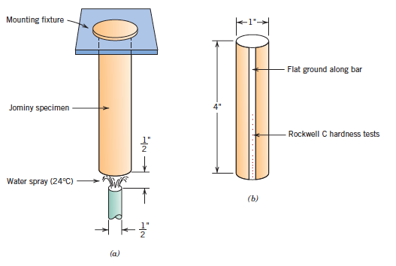
Jominy end quench test

Slide 2
Jominy end quench test
A cylindrical specimen with 25.4 mm diameter and 100 mm length is austenitized at a prescribed temperature for a specified time.
After removal from furnace it is mounted as shown in the figure in slide 147
The lower end of the cylinder is quenched by a jet of water of specified flow rate and temperature.
After the specimen is cooled to room temperature, shallow flats of 0.4 mm depth are ground along specimen length and Rockwell C hardness is measured along this length starting from the quenched end
A hardenability plot is obtained by plotting hardness as a function of distance from quenched end.

Slide 3
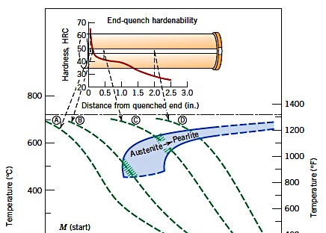

Hardenability plot from Jominy test

Slide 4
Hardenability plot from Jominy test
The quenched end is cooled most rapidly and as 100% martensite is formed here, highest hardness is obtained at this point
Cooling rate decreases with distance from the quench end and correspondingly hardness also decreases
With decreasing cooling rate more time is allowed for carbon diffusion ➔ correspondingly pearlite or a mixture of pearlite, martensite and bainite may form
A steel with high hardenability will retain high hardness at large distances ➔ the curve will be rather flat
For a steel with low hardenability, hardness will start dropping soon ➔ the curve will be steeper

Slide 5
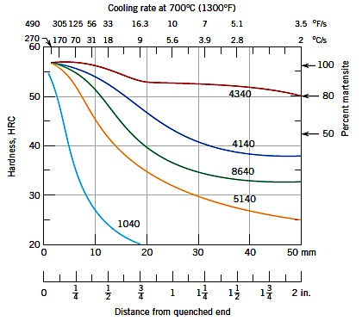
Steel composition & hardenability plot
Hardenability plots of five different steels, each having 0.4 wt.% C

Slide 6
Steel composition & hardenability plot
All five steels in the plot have the same C-content (0.4 wt.%).
However, apart from the steel 1040, the other four are alloy steels; the steel 1040 is plain carbon steel.
As the hardness of steel depends only upon its carbon content, all five steels have similar hardness at the surface.
Plain carbon steel, having the lowest hardenability, shows the steepest drop in hardness with distance.
The hardenability of other alloy steels depends upon their respective chemical compositions.

Slide 7
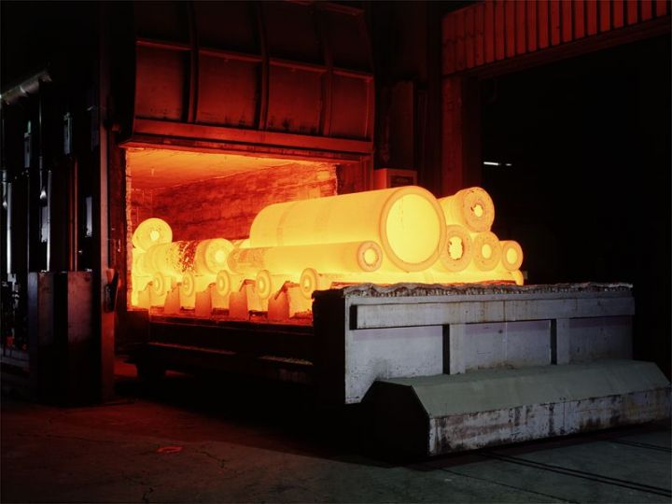
Heat treatment of steel
Heat treatment can be defined as:
A combination of heating and cooling operations, timed and applied to a metal or alloy in the solid state in a way that will produce desired properties.

Slide 8
Purposes of heat treatment of steel
To relieve the residual stresses arising from prior mechanical treatment or welding
To homogenize the steel to obtain a uniform distribution of alloying elments and properties
To soften the steel in order to subject it to mechanical deformation processes
To increase the notch toughness of the steel
To increase the strength and hardness of the steel
To modify the surface properties in order to increase the fatigue, wear or corrosion resistance

Slide 9
Basics of heat treatment of steel
The first step in steel heat treatment is to heat the material to some temperature in or above the critical range to form austenite
The rate of heating is normally not a critical process parameter
However, highly stressed materials or materials having critical geometry should be heated slowly to avoid distortions.
The component is kept at the chosen heat treatment temperature for certain period for homogenization
Subsequently it is cooled to room temperature at different rates depending upon the needed final properties

Slide 10
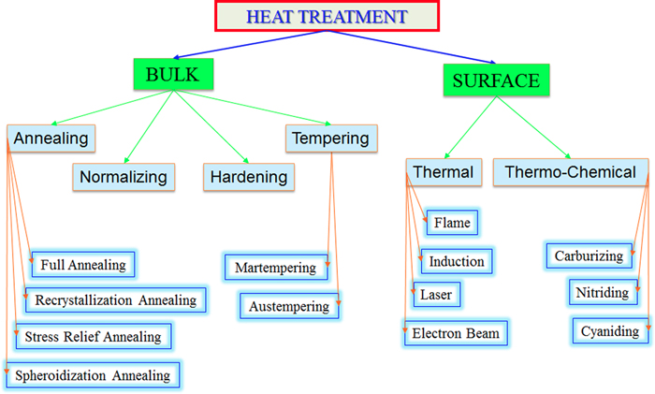
Basic classification

Slide 11
Full annealing
The process consists of heating the steel to the proper temperature and then cooling very slowly through the transformation temperature range.
The purpose of annealing may be to refine the grain, improve electrical and magnetic properties, improve machinability etc.
In annealing the sample is cooled very slowly inside a furnace.
Because of its very slow cooling rate, annealing comes closest to the Fe-Fe₃C diagram and the phase diagram can be used to predict the microstructures and phase fractions

Slide 12
Spheroidizing
This is a heat treatment process employed to improve the machinability of parts.
The microstructure after spheroidizing consists of globular or spheroidal carbides in a ferritic matrix.
Spheroidozong can be carried out by either:
Prolonged holding at a temperature just below A_{c1}
Heating and cooling alternately between temperatures that are just above and below the A_{c1} line
Heating to a temperature just above the A_{c1} line and then holding at a temperature just below the A_{c1} line

Slide 13
Spheroidizing
The spheroidized form of cementite is desirable when minimum hardness, maximum ductility or maximum machinability in high-cerbon steels is necessary.
Low carbon steels are seldom spheroidized as then the steel will be extremely soft and gummy and difficult to machine.
Medium carbon steels are often spheroidized to obtain maximum ductility for certain working conditions
Holding the steel for too long at spheroidizing temperature will coalesce the cementite particles ➔ will result in reduced machinability

Slide 14
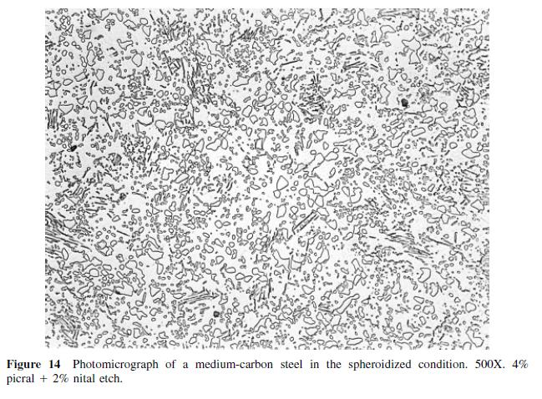
Spheroidizing

Slide 15
Stress relief annealing
Internal stresses may develop in components as a result of:
Plastic deformation processes such as machining and grinding
Non-uniform cooling of a component processed at a high temperature
Phase transformation during cooling wherein the parent and product phases have different densities
If these residual stresses are not relieved, distortion or warpage of the component may result.
These residual stresses are relieved by a suitable stress relief annealing heat treatment process

Slide 16
Stress relief annealing
The heat treatment process consists of three basic steps:
Heating to the recommended temperature
Holding at this temperature for a long enough time to attain uniform temperature throughout.
Final cooling to room temperature in air
The annealing temperature is normally rather low so that the properties resulting from prior heat treatment processes are not negatively influenced.

Slide 17
Normalizing
Normalizing heat treatment is carried out by heating the steel to approximately 50 °C higher than the upper critical temperature foolowed by cooling in still air.
The purpose of normalizing is to produce a steel harder and stronger than full annealing
Normalizing may also be used to improve machinability and refine the cast dendritic structures
As the cooling is no more occurring under equilibrium conditions, the phase diagram can not be used to predict the microstructure and phase fractions.

Slide 18
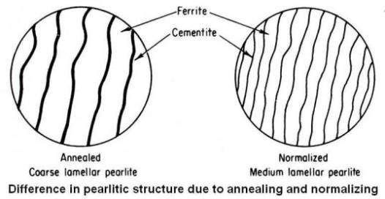
Normalizing
Schematic difference between annealed and normalized structure

Slide 19
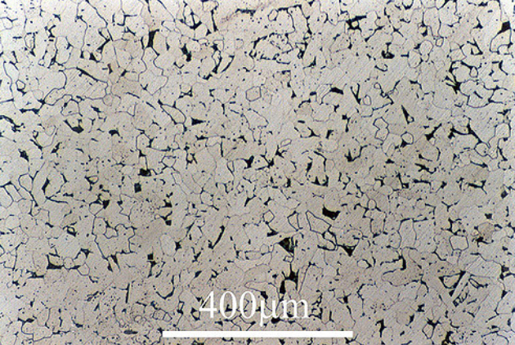
Normalizing
Typical microstructure of a normalised low carbon steel with 0.08% C

Slide 20
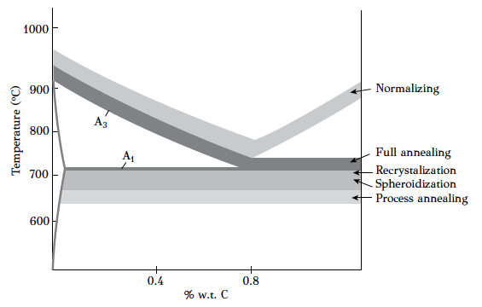
Region for annealing & normalizing

Slide 21
Attendance status as of 22.10.2018
0 marks
Not learning enough from the course

Slide 22
Hardening
The theoretical basics of hardening have already discussed. This include:
Physics of hardening of steel
Cooling curves
Martensitic transformation
Critical cooling rate for martensitic transformation
Tempering of martensite
Hatrdenability of steels
The more practical aspects of hardening will be discussed here.

Slide 23
Factors affecting cooling rate
There are several factors which affect the actual cooling rate. These are:
The type of quenching medium
The temperature of the quenching medium
The surface condition of the part
The size and mass of the part
These factors will be discussed very briefly in this course.

Slide 24
Effect of quenching medium
The ideal quenching medium should show a high initial cooling rate to avoid transformation at the nose region of CCT diagram and then a slower cooling rate at low temperatures to minimize distortion.
Unfortunately, no cooling medium is available which satisfies both these conditions.
Water allows a very fast cooling rate to avoid transformation at the nose region. However, the cooling rate remains the same even at room temperature ➔ danger of sample distortion
Cooling in air is too slow (hence no distortion); however it is too slow for hardening the steel

Slide 25
Effect of quenching medium
Listing of some common quenching media in order of decreasing quenching severity:
Water solution of 10% NaCl (brine)
Tap water
Fused or liquid salts
Soluble oil and water solutions
Oil
Air

Slide 26
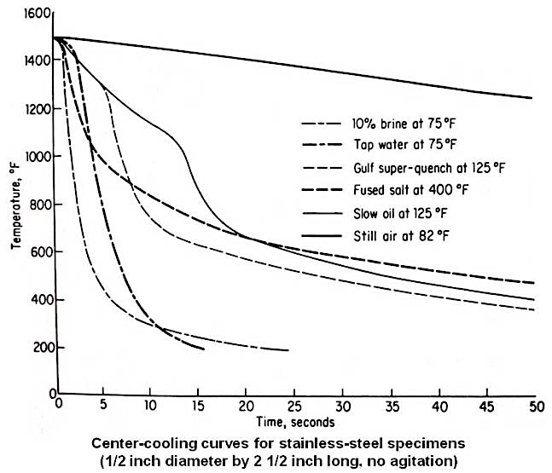
Effect of quenching medium

Slide 27
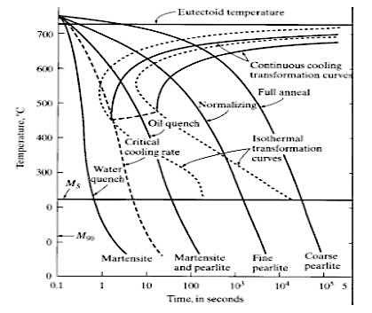
Effect of quenching medium

Slide 28
Lecture 5

Slide 29
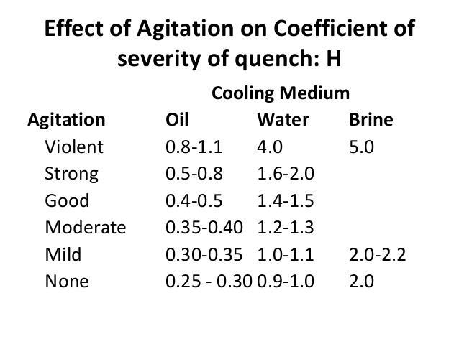
Quenching severity of different media

Slide 30
Effect of surface condition
When steel is exposed to an oxidizing atmosphere, due to the presence of oxygen/water vapor in furnace, a scale of iron oxide forms on the steel surface
During cooling after heat treatment, this scale can peel off at different locations of the component ➔ resulting into different cooling rates at different locations
Hence, variation in properties may arise.
Moreover, the scales may clog up the grinding wheen during machining operations
Care is taken so that no scaling occurs during heat treatment of steel.

Slide 31
Effect of size & mass
As only the surface of a piece is in contact with the quenching medium, the ratio of surface area to mass is an important factor in determining the cooling rate.
This ratio is strongly dependent upon the dimensions and shape of the component.
As the surface to mass ratio of the component increases, the cooling rate increases.
For components with spherical shapes, this ratio is inversely proportional to the diameter of the component (try finding it yourself).
Therefore, for a fixed quenching medium, as the diameter of the component increases, the cooling rate decreases

Slide 32
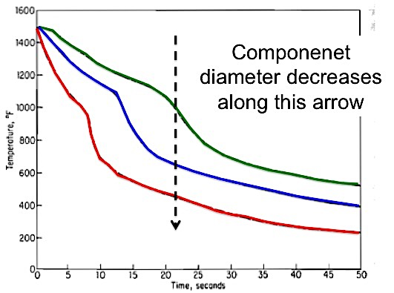
Effect of size & mass
Component diamater decreases along this arrow
Experimental data obtained for quenching of stainless steel in normal oil

Slide 33
Effect of size & mass
During quenching, the surface of any component, being in actual contact with the quenching medium is cooled at the fastest rate.
The heat in the interior of the component must be removed by conduction through the bodymass
Hence, the cooling rate at the interior of the component is slower than the surface.
Such a variation in cooling rate across the radius of a component will result in variation in hardness from the surface.

Slide 34
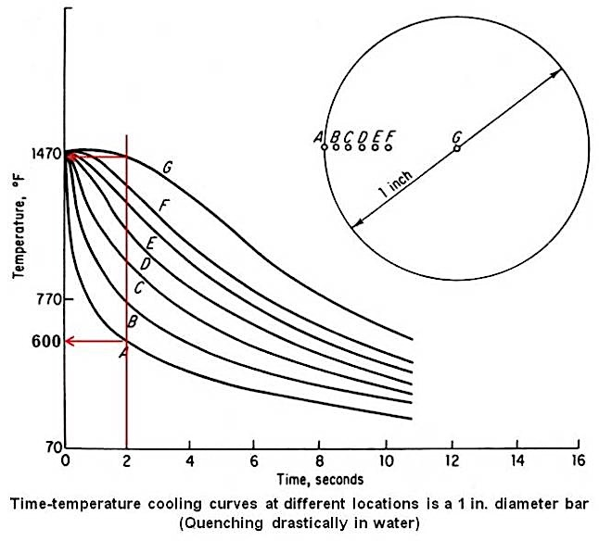
Effect of size & mass

Slide 35
Effect of size & mass
A steel bar witha diameter of 1 inch is cooled drastically by quenching in water
At any time, the surface of the bar will cool significantly faster than the center ➔ the temperature at the surface will be much lower
The red line shows, 2 sec. After quenching the surface is at 600 °C while the center will be at 1470 °C
Hence, there will be a temperature difference of 870 °C between the surface and the center
This huge temperature difference will generate stresses in the component, which may eventually distort it.

Slide 36
Austempering
This is a heat treatment process developed to obtain a 100% bainitic microstructure
After austenitizing, the part is rapidly cooled in a salt bath held in the bainitic temperature range.
The piece is left in the bath until the transformation of austenite to bainite is complete
Austempering is a complete heat treatment process and no reheating like tempering is needed.
Austempering has several advantages – greater ductility and toughness, higher hardness and lesser distortion and quench cracks
It is not suitable for bulky parts as there the necessary fast cooling rates in austempering are not achievable

Slide 37
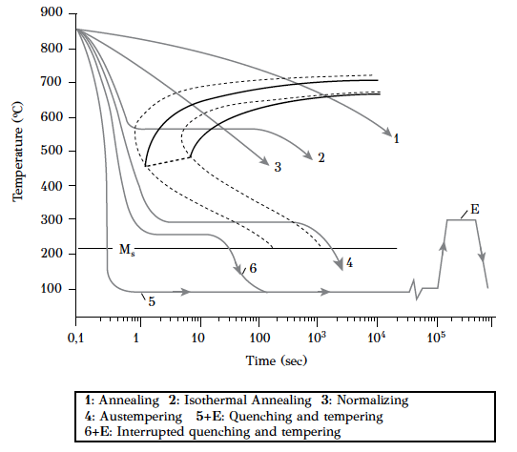
Schematic of various heat treatments

